Slide 1
Computer Organization and Assembly Language
Quiz 1 - Answers
Student Name : Ahmed Hany Hosny
Section 2
Prof. Mohamed Abd Elfattah
Misr Higher Institute for Commerce and Computers
2019 - 2020

Slide 2
Answer for Q1

Slide 3
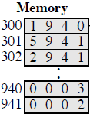
Fetch – 1st Cycle
300
Program Counter (PC)
Instruction Register (IR)
Accumulator (AC)

Slide 4
Decode – 1st Cycle
300
Program Counter (PC)
1940 (LOAD 940)
Instruction Register (IR)
Accumulator (AC)

Slide 5
Execute – 1st Cycle
300
Program Counter (PC)
1940 (LOAD 940)
Instruction Register (IR)
Accumulator (AC)
0003

Slide 6
Fetch – 2nd Cycle
301
Program Counter (PC)
Instruction Register (IR)
Accumulator (AC)
0003

Slide 7
Decode - 2nd Cycle
301
Program Counter (PC)
5941 (ADD 941)
Instruction Register (IR)
Accumulator (AC)
0003

Slide 8
Execute - 2nd Cycle
301
Program Counter (PC)
5941 (ADD 941)
Instruction Register (IR)
Accumulator (AC)
0005

Slide 9
Fetch – 3rd Cycle
302
Program Counter (PC)
Instruction Register (IR)
Accumulator (AC)
0005

Slide 10
Decode – 3rd Cycle
302
Program Counter (PC)
2941 (STORE 941)
Instruction Register (IR)
Accumulator (AC)
0005

Slide 11
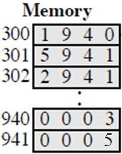
Execute – 3rd Cycle
302
Program Counter (PC)
2941 (STORE 941)
Instruction Register (IR)
Accumulator (AC)
0005

Slide 12
After the completion of the 3 fetch-execute cycles, we can see that: PC contains 302 IR contains 2941 AC contains 0005 and each location in the memory contains the following:

Slide 13
Answer for Q2

Slide 14
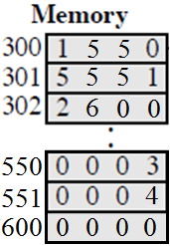
Fetch – 1st Cycle
300
Program Counter (PC)
Instruction Register (IR)
Accumulator (AC)

Slide 15
Decode – 1st Cycle
300
Program Counter (PC)
1550 (LOAD 550)
Instruction Register (IR)
Accumulator (AC)

Slide 16
Execute – 1st Cycle
300
Program Counter (PC)
1550 (LOAD 550)
Instruction Register (IR)
Accumulator (AC)
0003

Slide 17
Fetch – 2nd Cycle
301
Program Counter (PC)
Instruction Register (IR)
Accumulator (AC)
0003

Slide 18
Decode – 2nd Cycle
301
Program Counter (PC)
5551 (ADD 551)
Instruction Register (IR)
Accumulator (AC)
0003

Slide 19
Execute – 2nd Cycle
301
Program Counter (PC)
5551 (ADD 551)
Instruction Register (IR)
Accumulator (AC)
0007

Slide 20
Fetch – 3rd Cycle
302
Program Counter (PC)
Instruction Register (IR)
Accumulator (AC)
0007

Slide 21
Decode – 3rd Cycle
302
Program Counter (PC)
2600 (STORE 600)
Instruction Register (IR)
Accumulator (AC)
0007

Slide 22
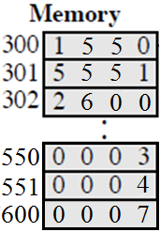
Execute – 3rd Cycle
302
Program Counter (PC)
2600 (STORE 600)
Instruction Register (IR)
Accumulator (AC)
0007

Slide 23
After the completion of the 3 fetch-execute cycles, we can see that: PC contains 302 IR contains 2600 AC contains 0007 and each location in the memory contains the following:

Slide 24
Answer for Q3

Slide 25
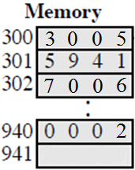
Step 1: 3005 → IR
Step 2: 3 → AC
Step 3: 5940 → IR
Step 4: 3 + 2 = 5 → AC
Step 5: 7006 → IR
Step 6: AC → Device 6

